Slide 1
Exploring Student Performance using Power BI
By: Qassem Al-Hanbali

Slide 2
Introduction
The data approach student achievement in secondary education of two Portuguese schools. The data attributes include (student grades, demographic, social and school related features) and it was collected by using school reports and questionnaires.
This study can help educational institutions to improve students' performance by identifying and addressing areas of weakness.

Slide 3

Data Preparation
Dataset has no missing or noisy values, but some modifications has been made using (Power BI) in order to get better results:
The (Don’t summarize) option has been used for some columns to get the count or frequency.
New column has been added to view the calculation of the mean of the grades of students.

Slide 4
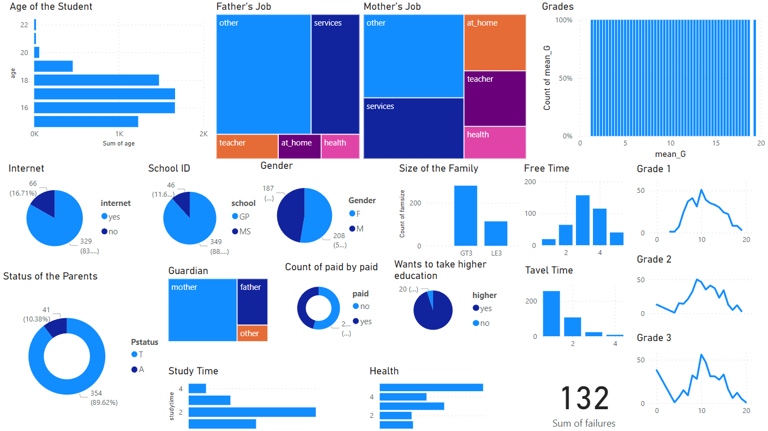
The Dashboard

Slide 5
Some of the conclusions
The more students want to enroll in higher education, the higher their average score in exams.
The higher the quality of family relations, the higher the student's grades.
The health status doesn't have a high effect to the student's grades .

Slide 6
Sources
https://www.kaggle.com/datasets/devansodariya/student-performance-data
https://www.kaggle.com/code/mohamedmohsen3330/data-analysis-students-performance
https://archive.ics.uci.edu/dataset/320/student+performance

Slide 7
Thank You

